Slide 1
Development of MCQ System
Module Project
Module: Programming Foundations
Course: Applied Degree in Software Engineering
Start Date :
End Date : 12 June 2022
Submission Date : 12 June 2022
Learner Name : Viddy Virstandi P.A.P
Enrollment ID :
Presentation Date :

Slide 2
Document History
Version Number | Effective Date of release | Summary of Included Changes | Author
1 | 1 Jul 21 | First Edition | Jeyashree

Slide 3
Contents
Project Definition
Project Deliverables
Project Milestones & Tasks
Project Environment
Tools
Project Design
Classes & Methods
Steps from Coding to Execution
Development Process
Coding Standard
Milestone Feedback & Action Taken
Project Results
Proposed Improvements

Slide 4
1. Project Definition
Project Objective
  To developed working MCQ System application
    Test and validate to meet the project requirement
  To creating a report
  To creating Presentation
Proposed Solution
  Build the algorithm and design the flow chart
  Developed the MCQ project in IntelliJ IDEA
  Test and debug the application to fix any error
  Produce report and persentation

Slide 5
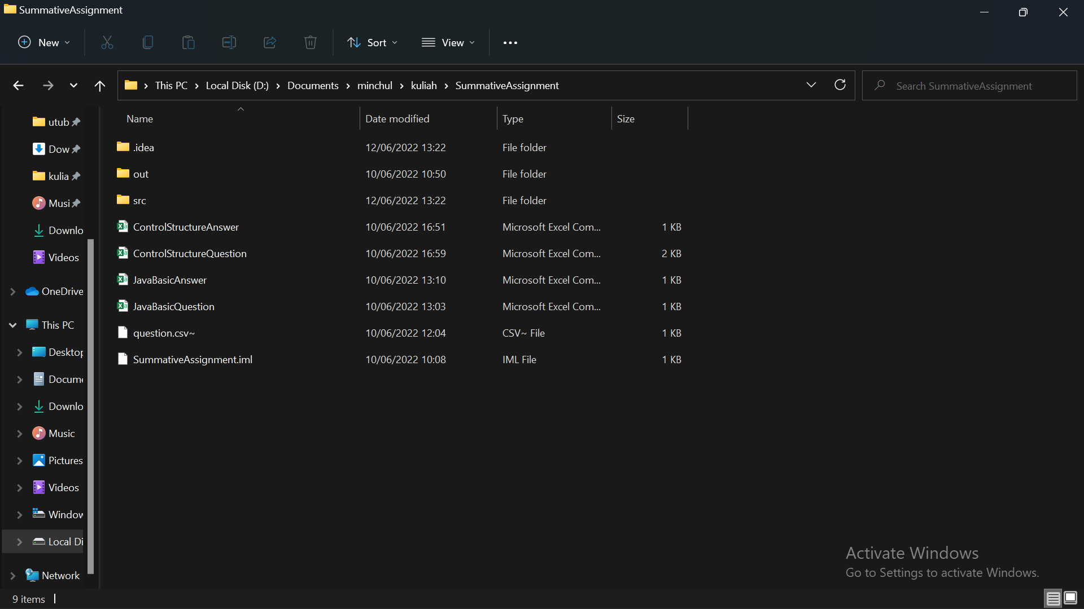
2. Project Deliverables
Project Deliverables
  Source code for the working MCQ System
  Project report
  Project Presentation
List of Evidences
  Screenshots of the project directory

Slide 6
3. Project Milestones & Tasks
Project Task ID | Project Task Description | Project Milestone ID
1 | Create Requirement Specification | 1
2 | Develop Algorithm | 1
3 | Analysis and Design | 2
4 | Create the Application | 2
5 | Test the Application | 3

Slide 7
4. Project Environment
Technical Environment and Tools Used
  Java JDK 1.8
  IntelliJ IDEA
  draw.io
  Microsoft Excel
  Microsoft Word
  Microsoft Power Point
List of references
  https://www.cs.odu.edu/~toida/nerzic/content/recursive_alg/rec_alg.html
  https://www.javatpoint.com/
  https://www.technologyuk.net/computing/software-development/software-design/event-driven-programming.shtml
  https://www.jobsity.com/blog/5-programming-paradigms-you-should-know-about
  https://github.com/kelasterbuka/JAVA_dasar_programming
  https://github.com/kelasterbuka/JAVA_Lanjut_OOP
  My friend

Slide 8
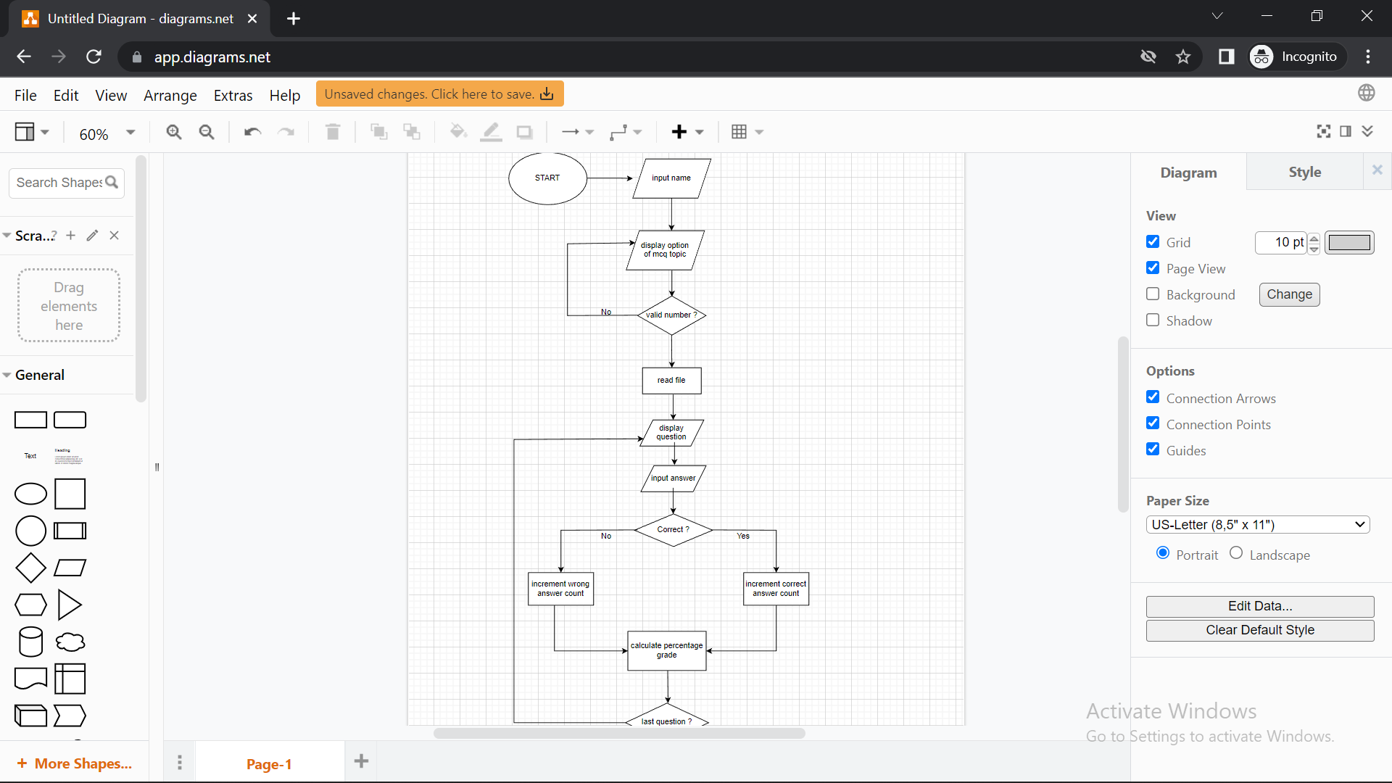
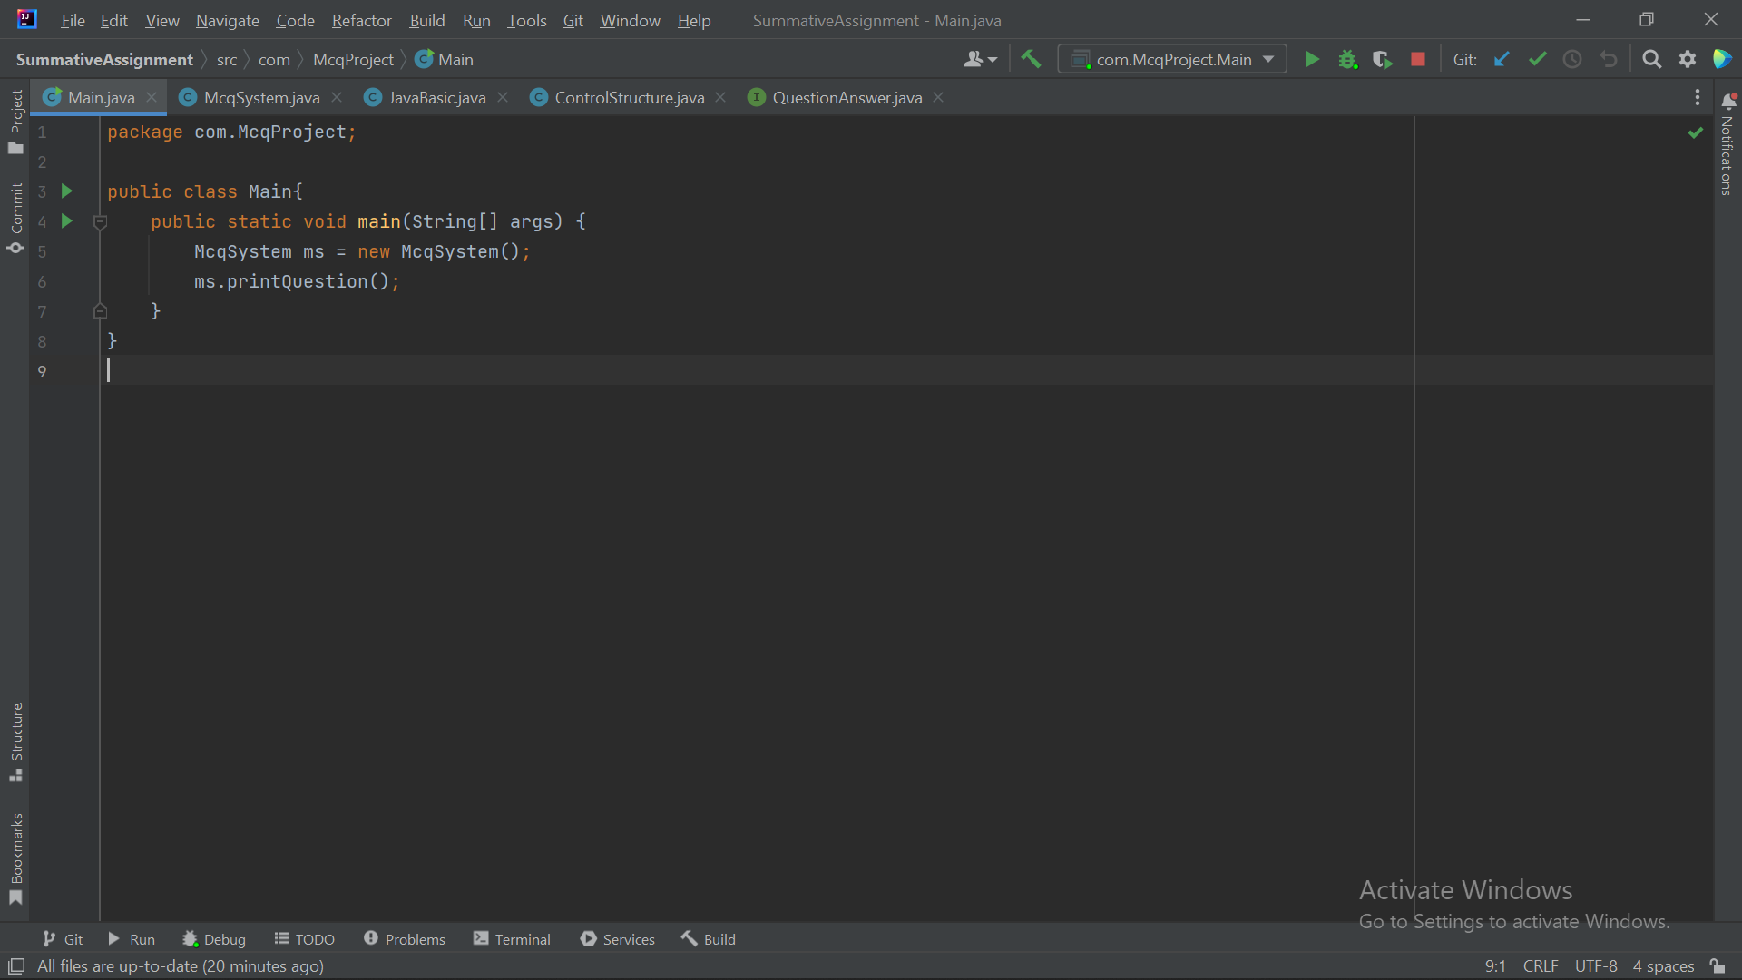
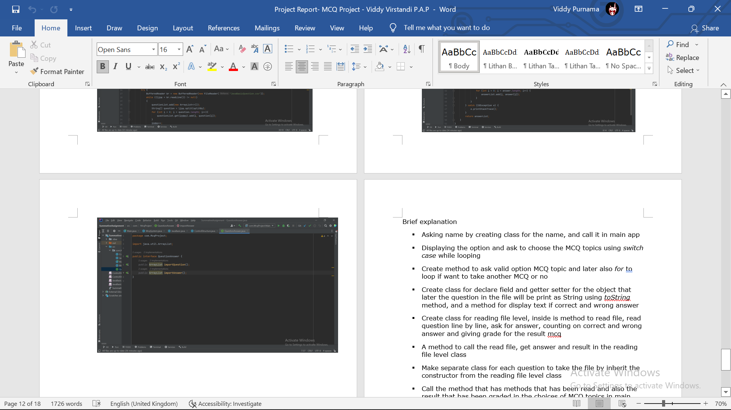
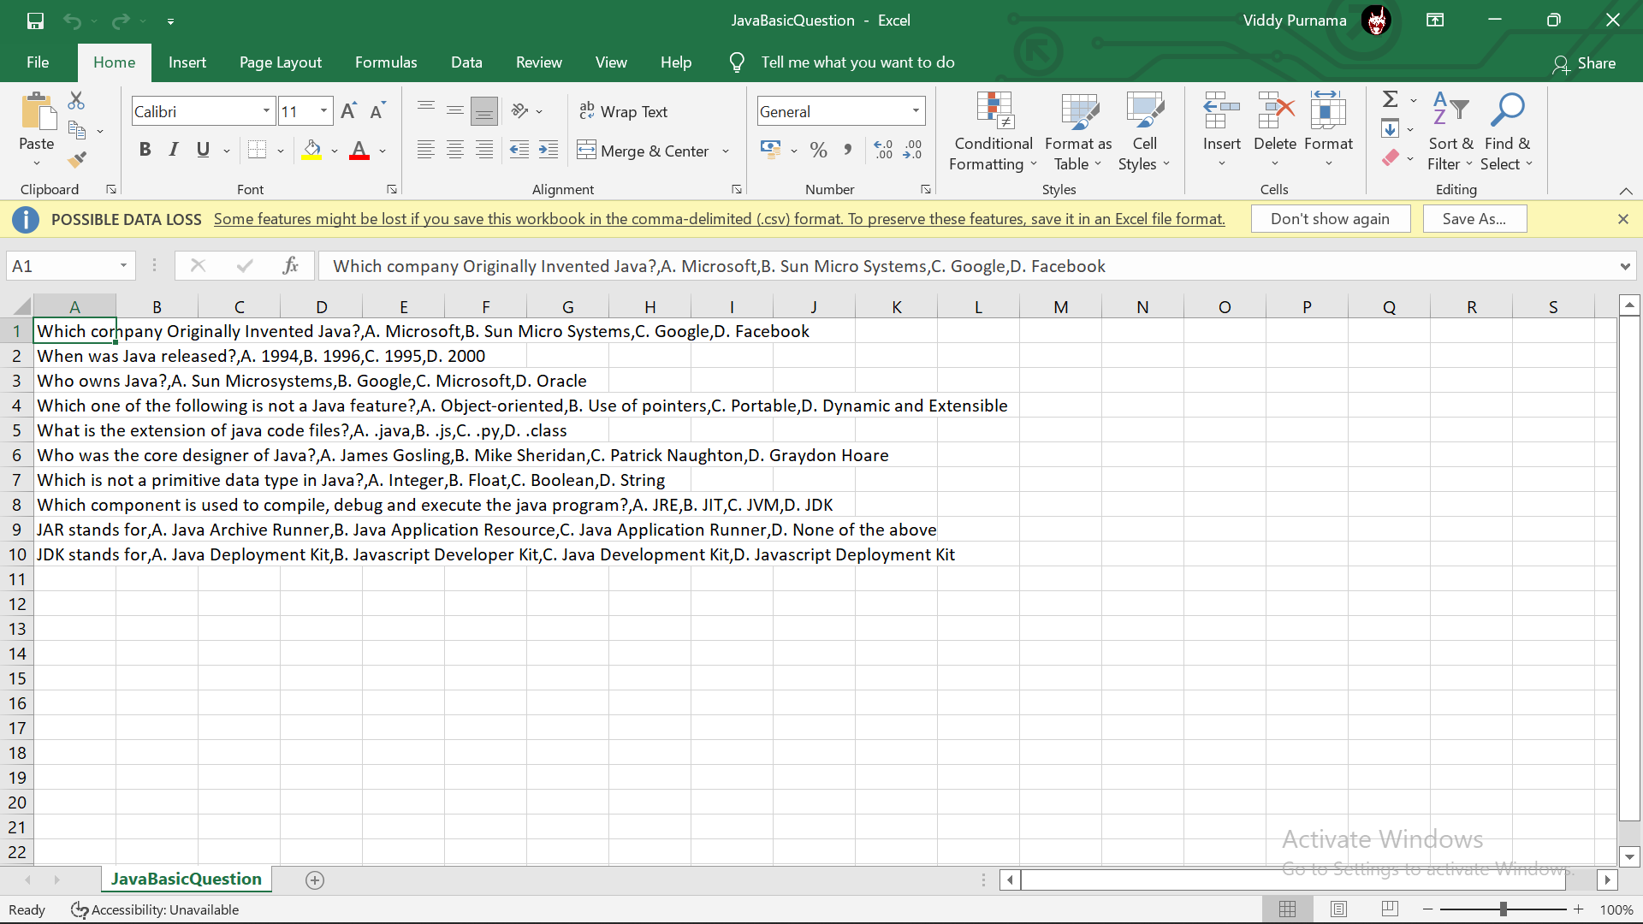
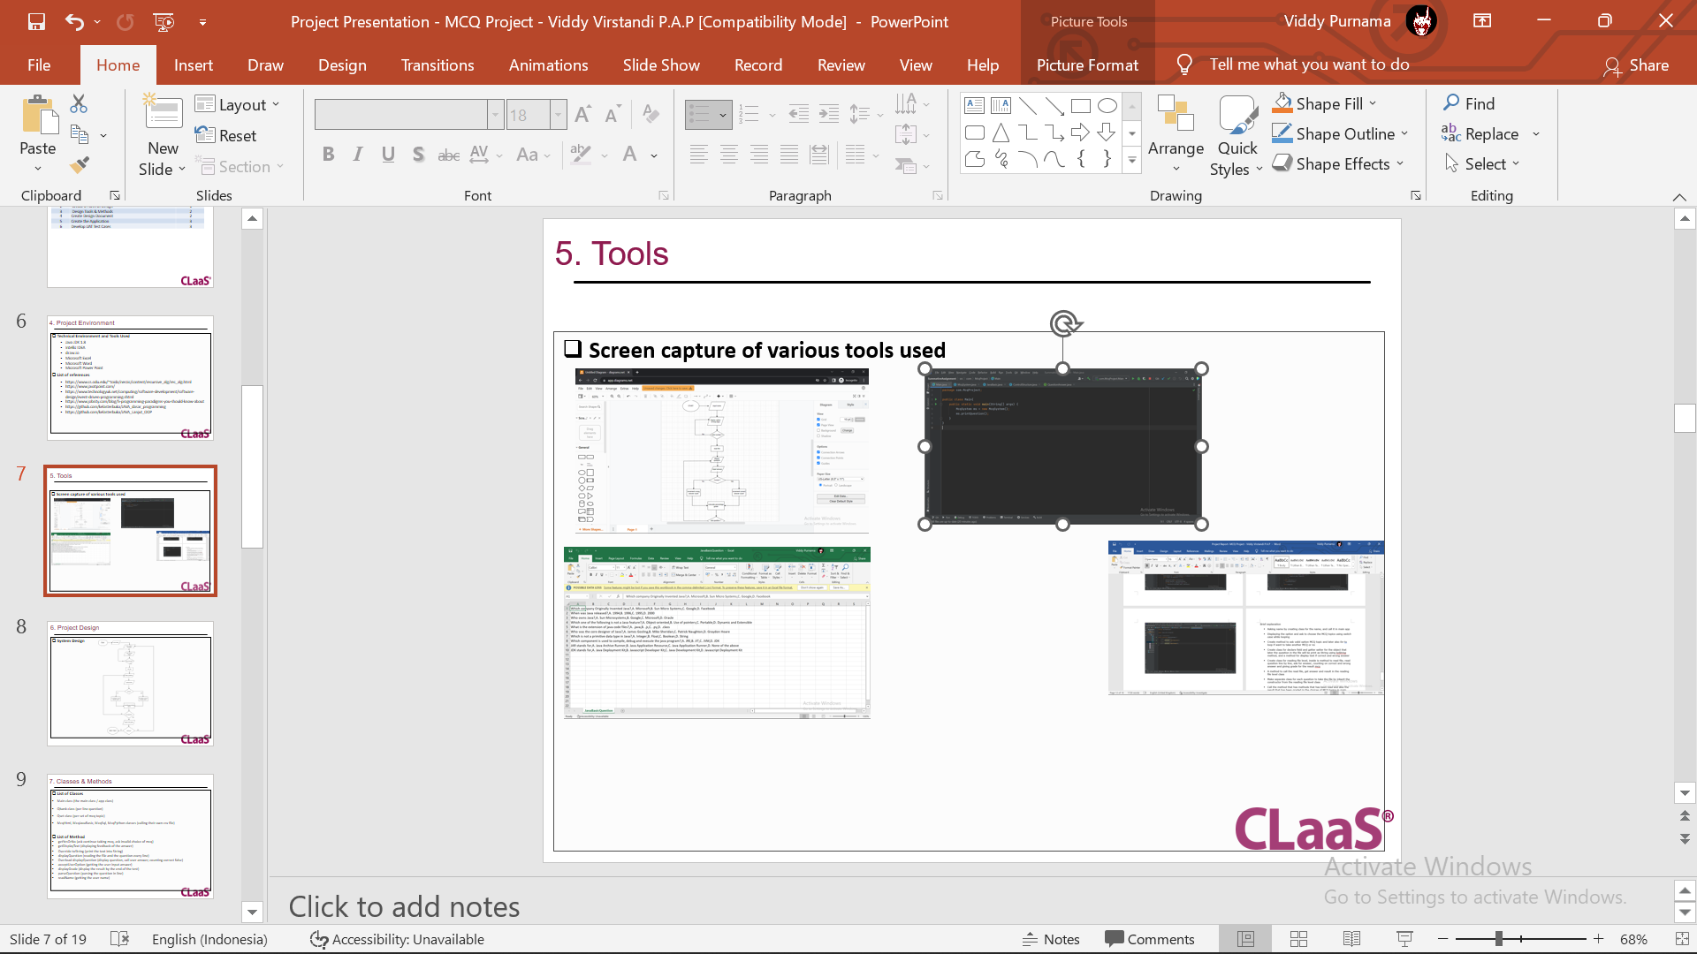
5. Tools
Screen capture of various tools used

Slide 9
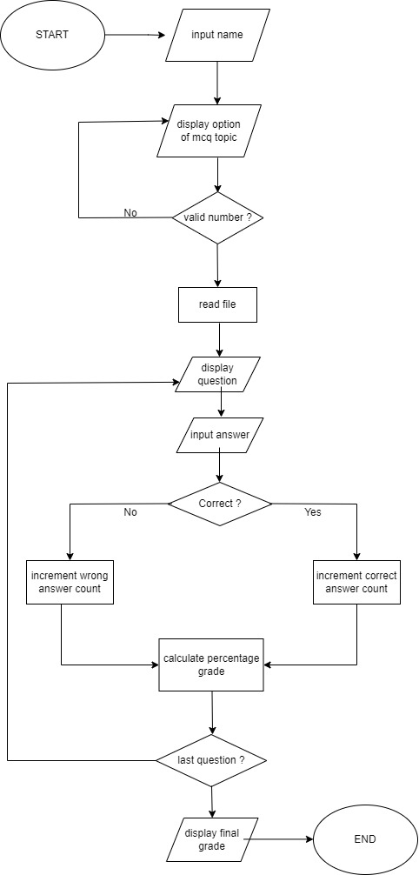
6. Project Design
System Design

Slide 10
7. Classes & Methods
List of Classes
Main.java
McqSystem.java
JavaBasic.java
ControlStructure.java
QuestionAnswer.java
List of Method
importQuestion()
importAnswer()
printQuestion()

Slide 11
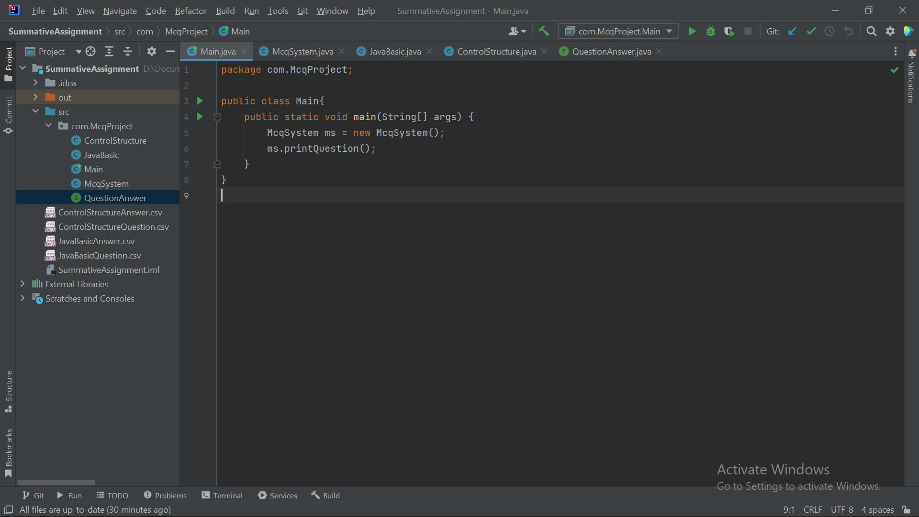
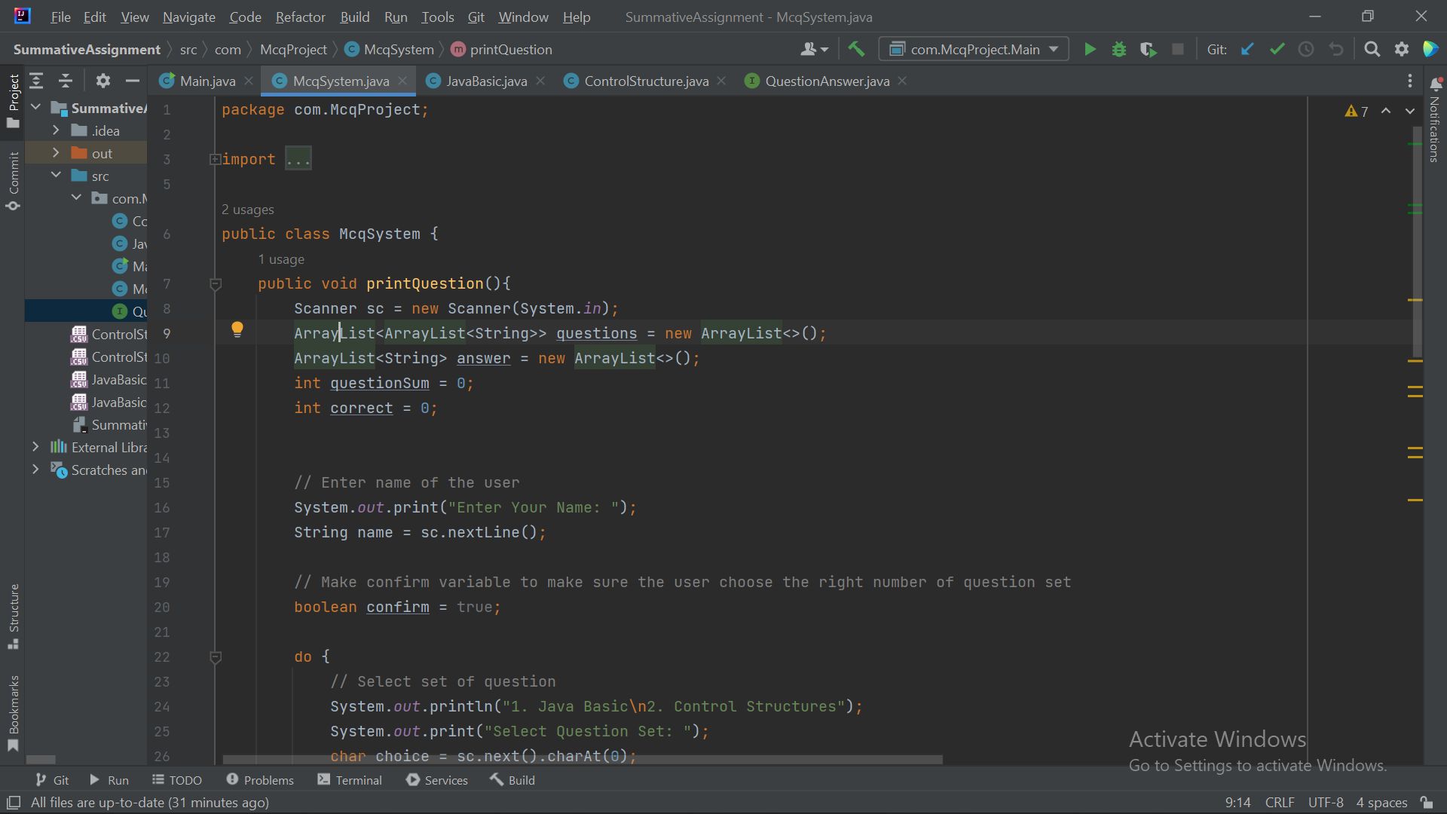
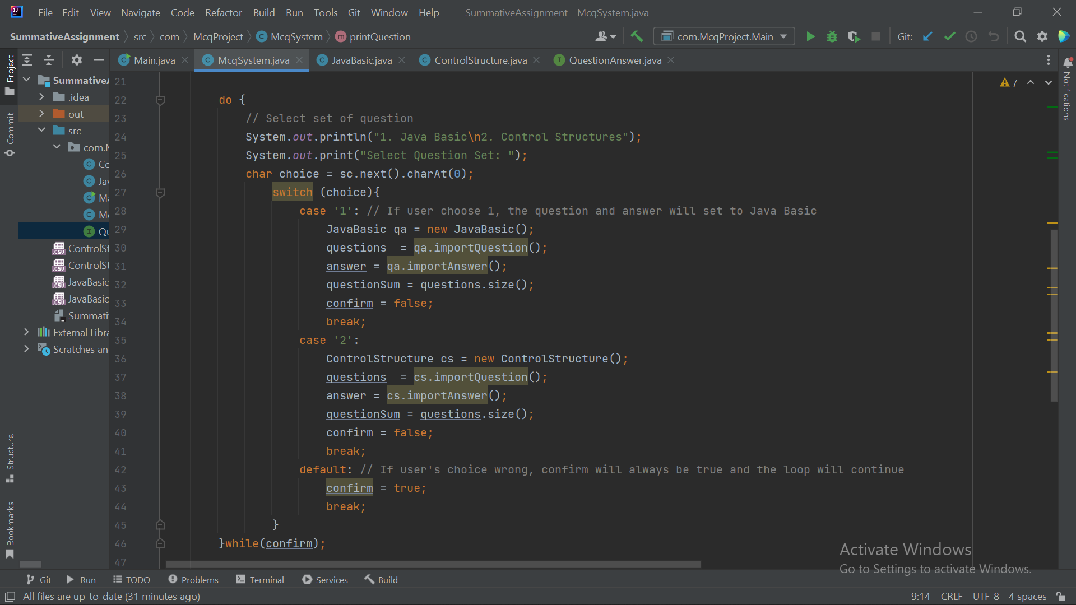
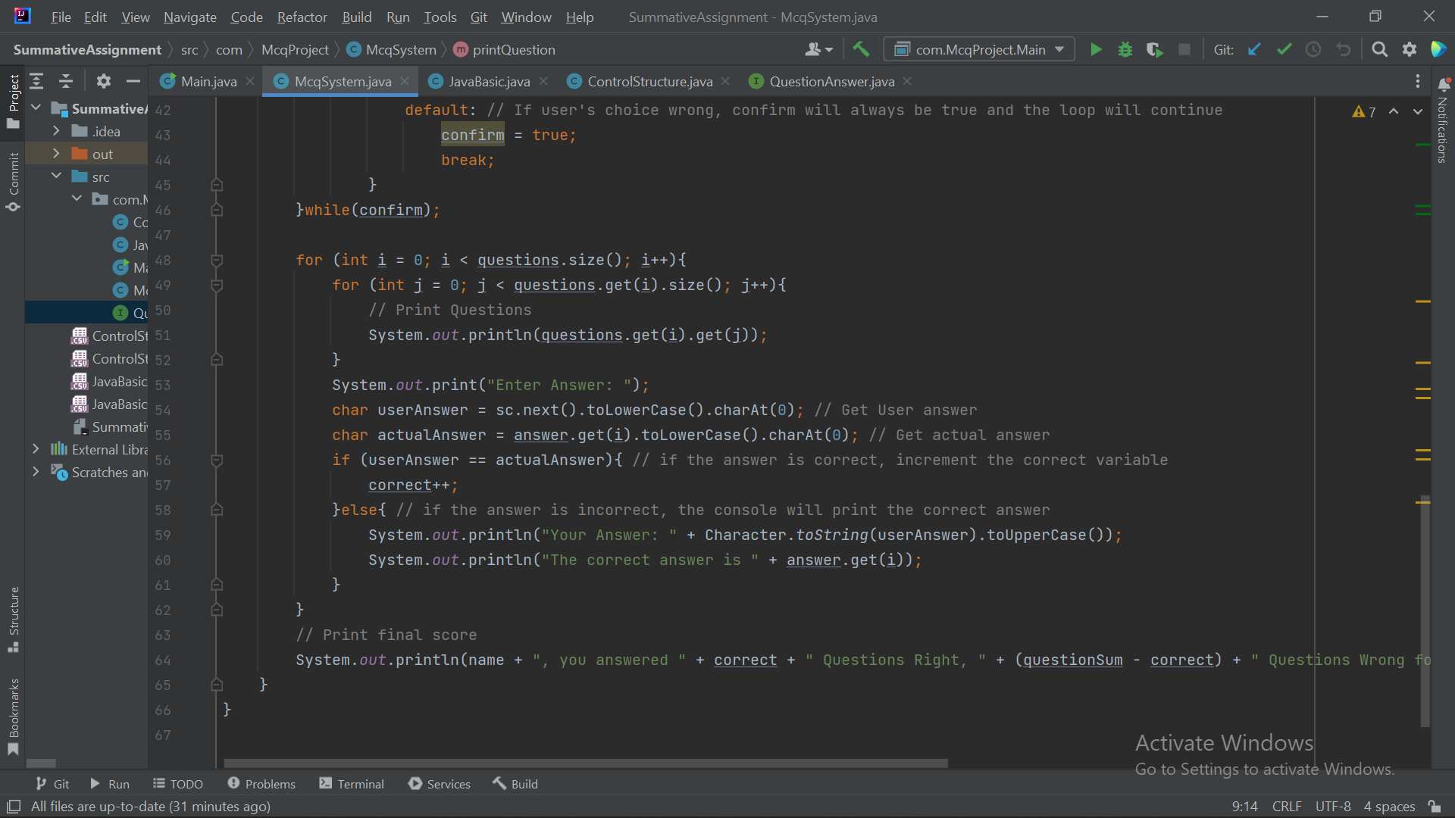
8. Steps from Coding to Execution

Slide 12
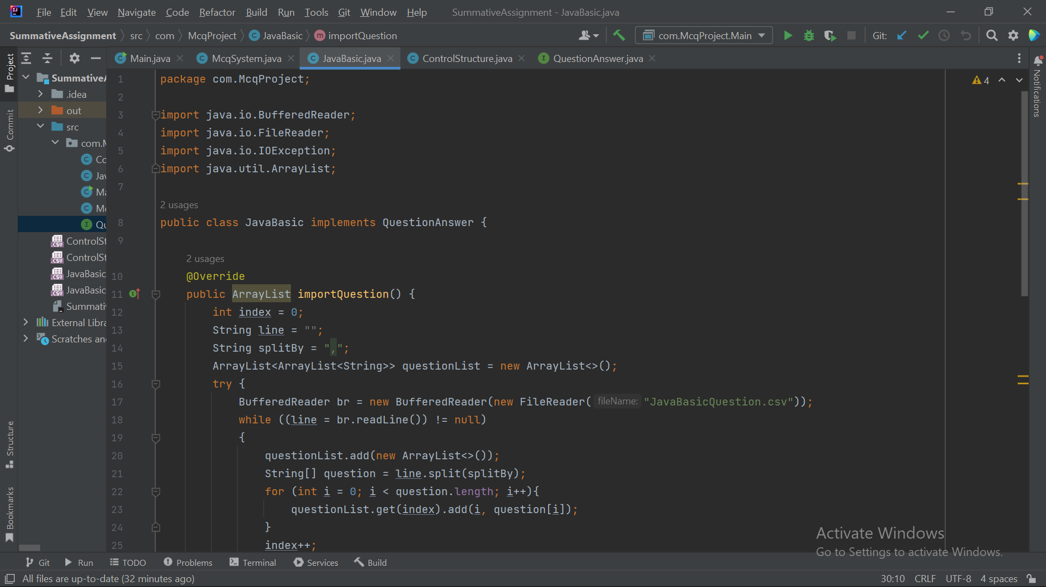
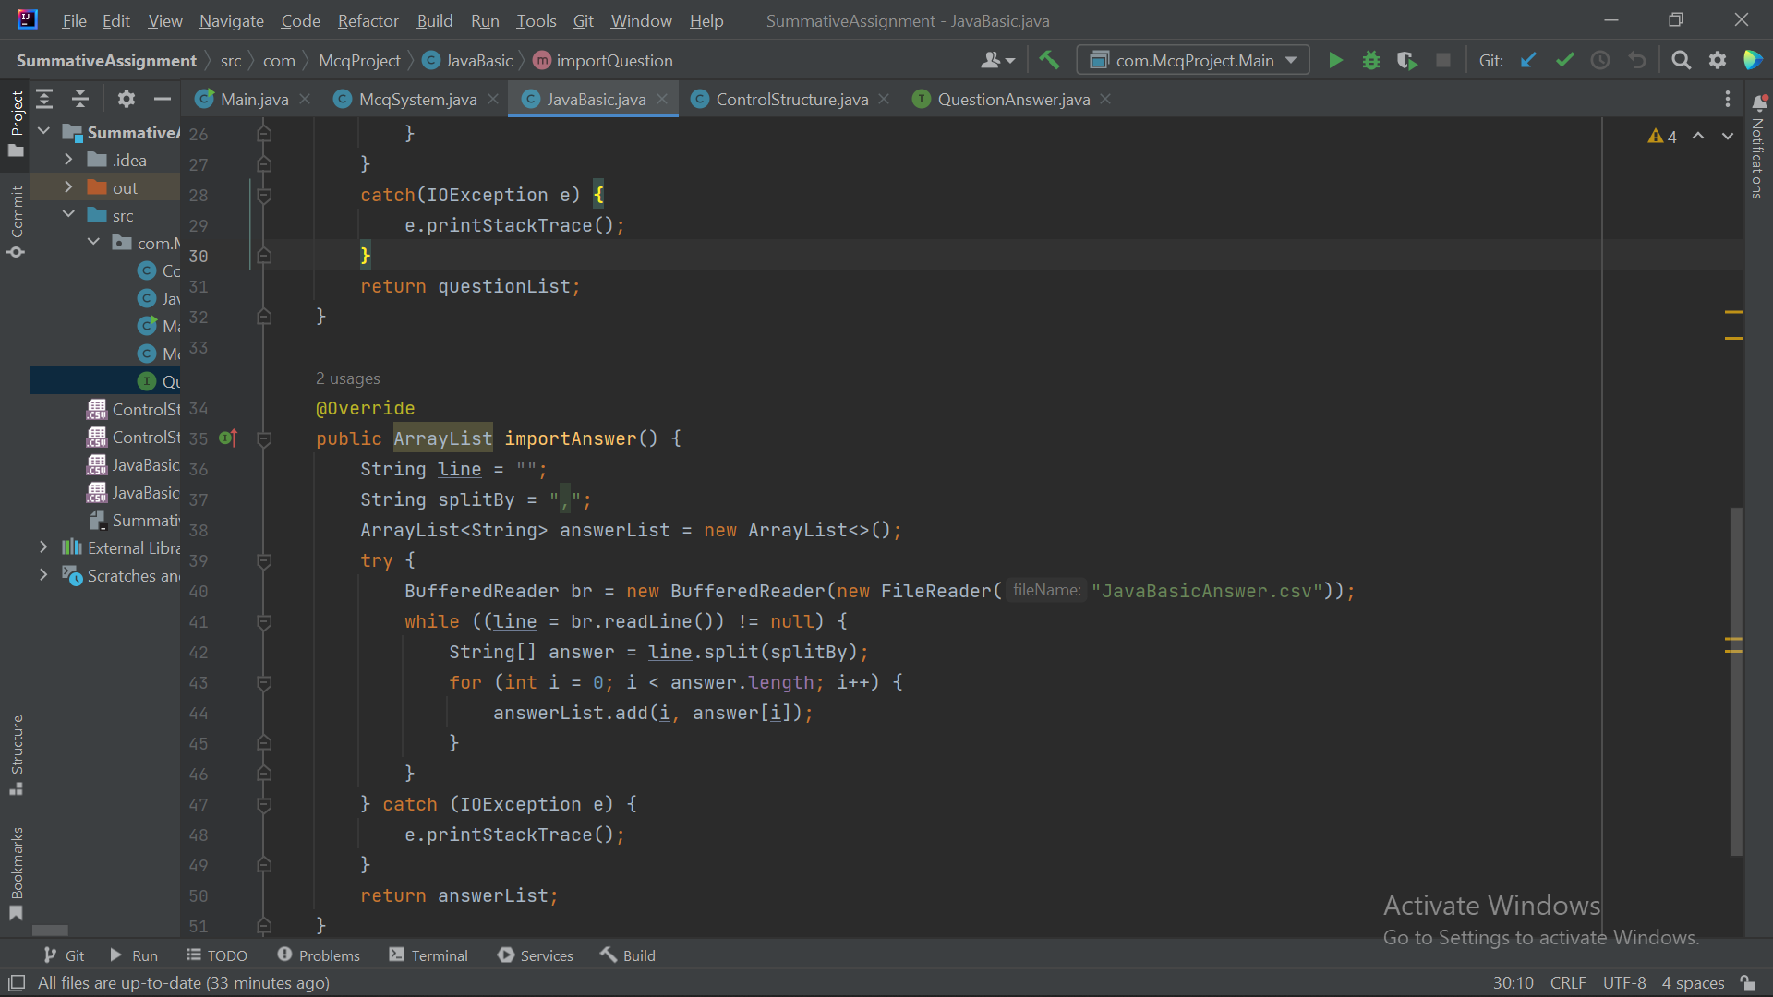
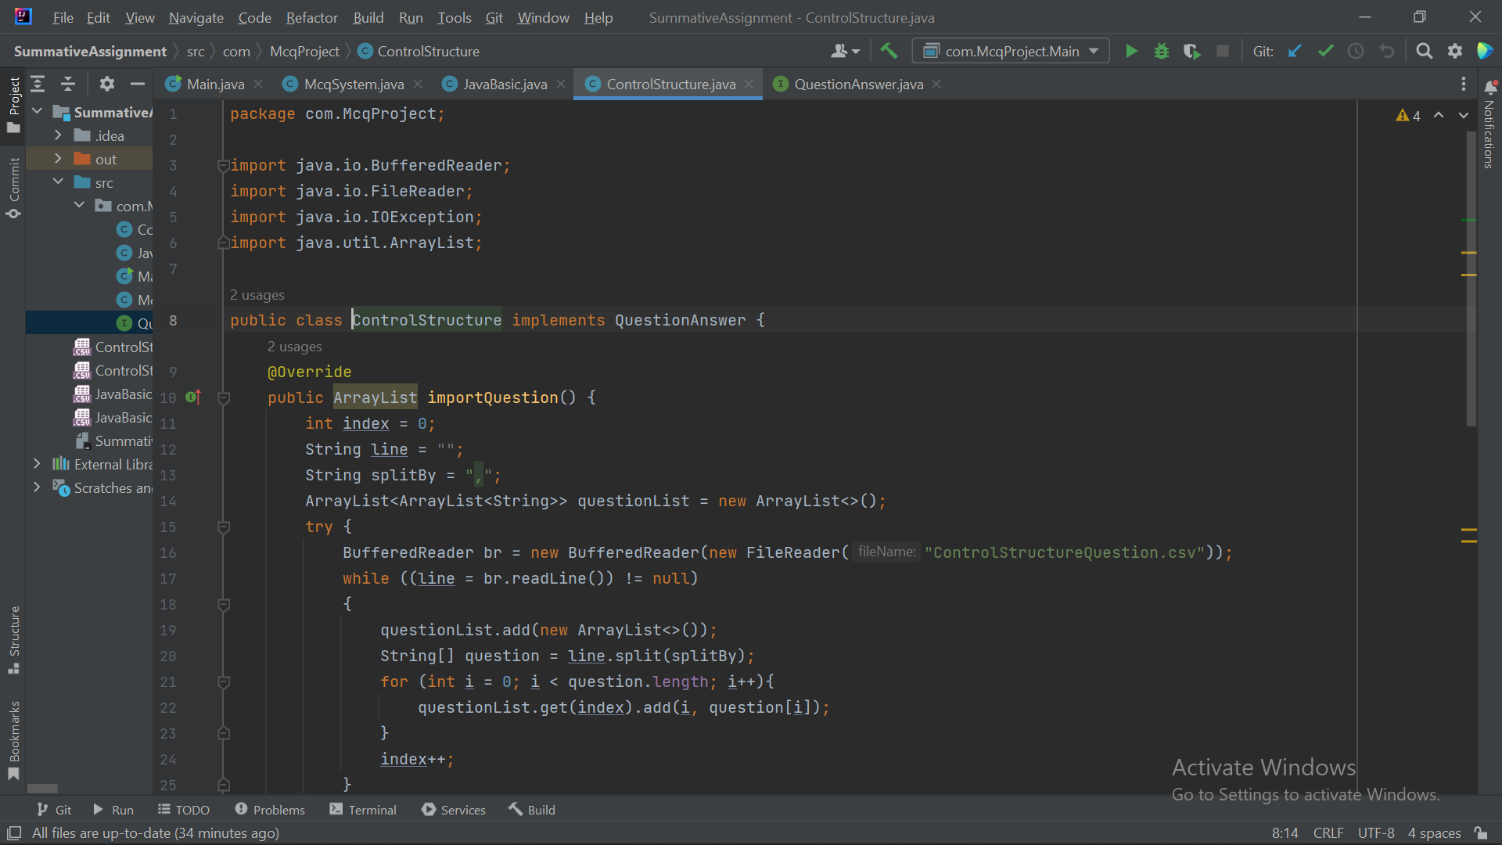
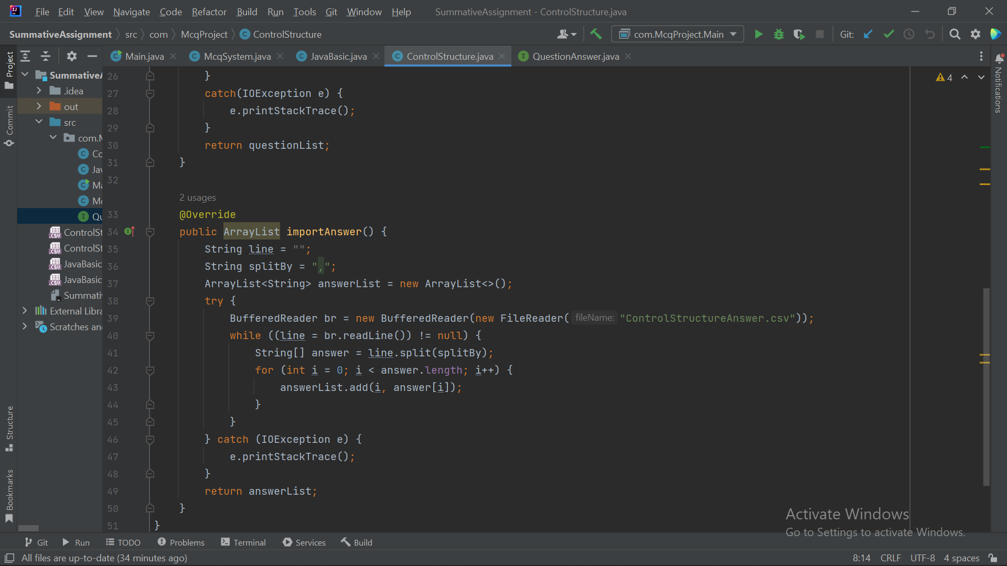
8. Steps from Coding to Execution

Slide 13
Steps from Coding to Execution
Input: your name, your answer
Step1: ask to put your name
Step2: input the name in the space that’ve been provided
Step3: display the MCQ topics option from 1 or 2
Step4: input the choice number between 1 or 2
Step5: If user enter number outside the range, ask again to put number between 1 or 2
Step6: read the chosen MCQ topic from the csv file
Step7: display the question and ask for answer
Step8: input the “a/b/c/d” answer
Step9: if correct, show that you are correct and increment the correct
Step10: if wrong, show the correct answer and increment the wrong
Step12: calculate the grade by using percentage (%)
Step13: after the last question display the input name, how many correct and false answer, result grade and message grade of MCQ test
Step14: otherwise continue displaying question goes to step7
Expect Output: result grade of MCQ

Slide 14
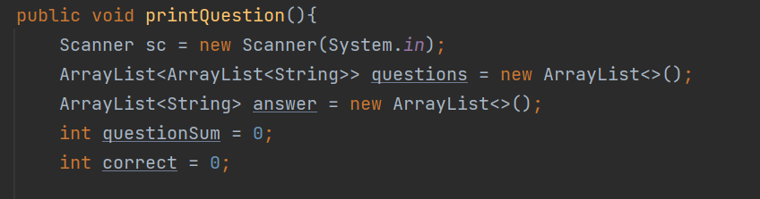
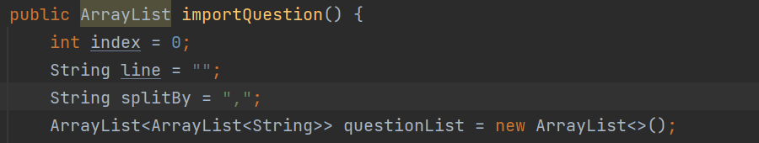
Coding Standard
Naming convention
Naming Method using mixed case and a verb

Slide 15
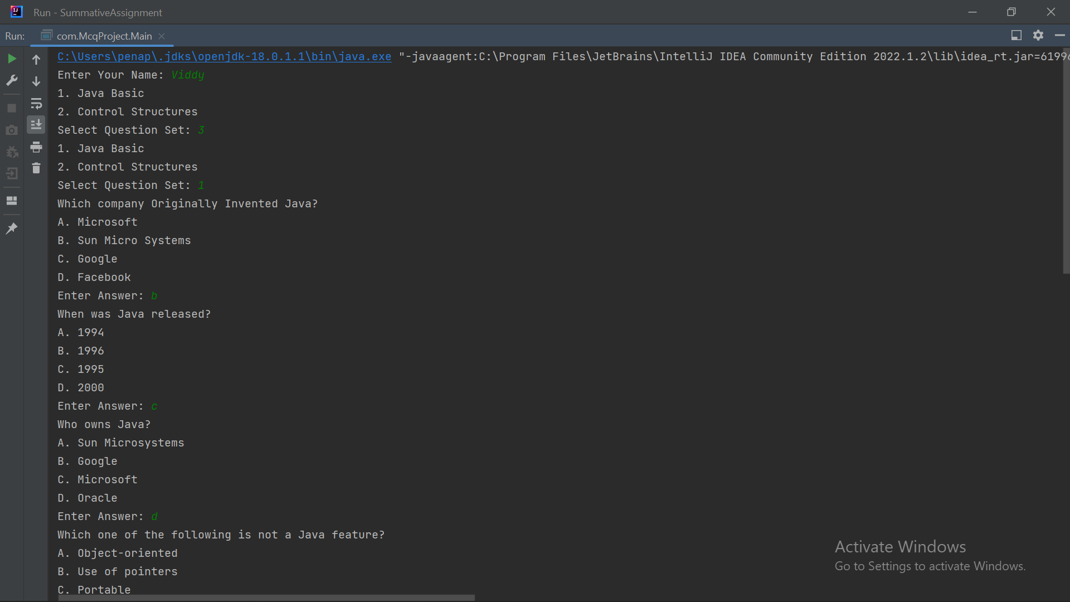
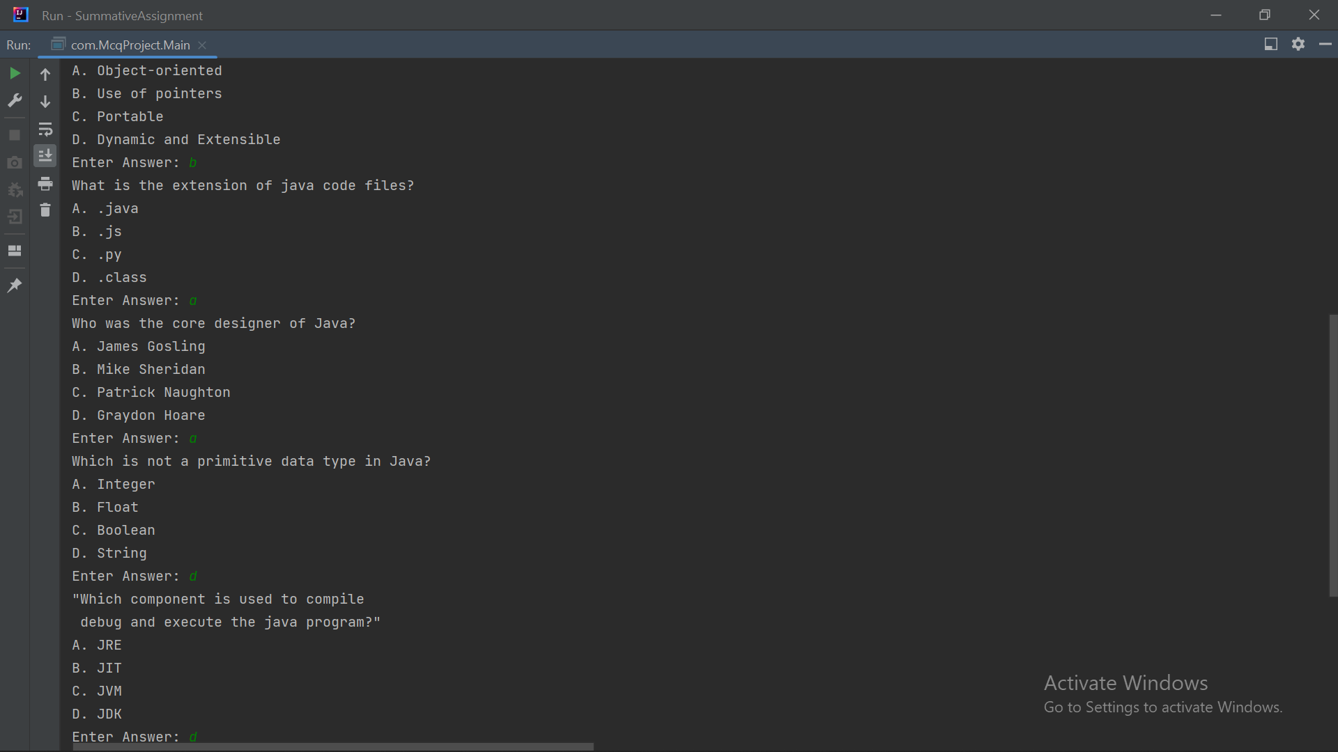
Project Results

Slide 16
Proposed Improvements
List of Improvements
  Using If statement and switch case
  Using while for looping
  Made private instance variable in class to restrict visibility, and can be accessed only when created the getter setter method.
  Differentiate whose going to be the parent class and who will inherited
  Separate method for doing the task and who is going to call the other method for display it
  Know why OOP is more effective

